Slide 1
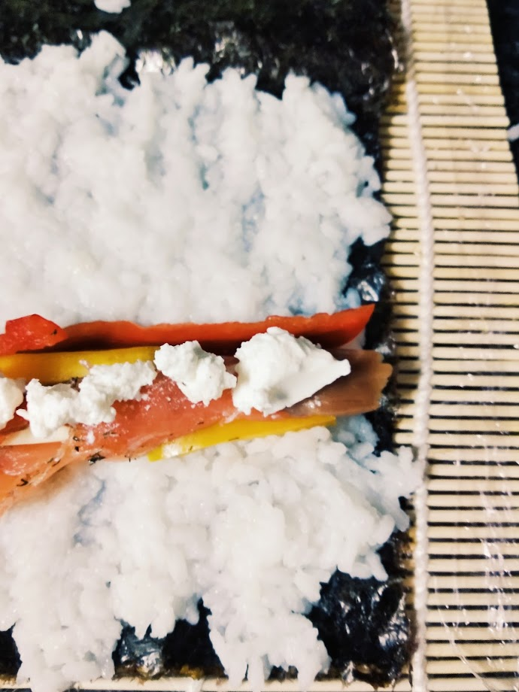
SIEM PROJECT 1 Mockup Submission
Leonor Santos
(up201504515)
5/10/2020

Slide 2
Subject Description

Slide 3
University Student @ the kitchen
As the main theme of this static web page, it was chosen: “University Student @ the kitchen: 101”.
While studying at FEUP, I found myself concerned to maintain balanced and nourishing eating habits, which I must promptly conciliate with my academic and personal life.
This subject provides content to build the HTML and CSS code which altogether will result in a web site and its static pages.

Slide 4
Color Choice

Slide 5
Color palette
#865336 | #CB997E | #DDBEA9 | #FFE8D6 | #B7B7A4 | #A5A58D | #6B705C

Slide 6
Page info

Slide 7
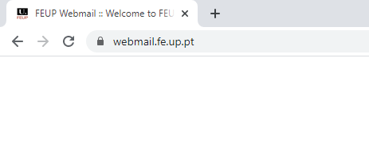
Web Page Info
Uni Student @ Kitchen
URL
Site logo as tab icon
Shortened title to fit space

Slide 8
Cover Page- Light Mode

Slide 9


Recipes | Tips | About Me | Downloads
Dark Mode
University
Student
@ the
Kitchen

Slide 10
Recipes | Tips | About Me | Downloads
Dark Mode
Margin 1vw
Margin 2vw
Center cover image
University
Student
@ the
Kitchen
Margin 2vw

Slide 11
Recipes | Tips | About Me | Downloads
Dark Mode
Hover
Underline
Color: #6B705C
Site logo as homepage link
Align: left
Alternative text: website-logo
Tooltip: Homepage
University
Student
@ the
Kitchen
Nave bar
Family-font: Darker Grotesque
Font-size: 2vw
Color: #865336
Text-align: left
Padding: 16px

Slide 12
Recipes | Tips | About Me | Downloads
Dark Mode
Hover
Color: #6B705C
Changes into dark Mode
University
Student
@ the
Kitchen
Family-font: Bellota
Color: #865336
Text-align: left
Padding: 20px
Bckground-color: #FFE8D6
Transparency:25%

Slide 13
Page overview:
Family-font: Darker Grotesque
Color: #6B705C
Text-align: right
Padding: 10px
Background-color: #FFE8D6
Transparency:0%
When a uni student tries to balance healthy eating habits, academic responsibilities and personal life, anything can happen.
Here, there’s a sneak pic at the colourful (hopefully) meals, for those looking for inspiration. Meanwhile, a foodie is growing strong.

Slide 14
Cover Page- Dark Mode

Slide 15

Recipes | Tips | About Me | Downloads
Light mode
University
Student
@ the
Kitchen

Slide 16
Recipes | Tips | About Me | Downloads
Light mode
Hover
Underline
Color: #FFE8D6
Nave bar
Color: #FFE8D6
Background-color: #6B705C
Site logo (2) as homepage link
Align: left
Alternative text: website-logo
Tooltip: Homepage
University
Student
@ the
Kitchen

Slide 17
Recipes | Tips | About Me | Downloads
Light mode
Hover
Color: #6B705C
University
Student
@ the
Kitchen
Nave bar
Color: #FFE8D6
Background-color: #6B705C
Transparency:25%

Slide 18
Page overview:
Color: #FFE8D6
Background-color: #6B705C
Transparency:0%
When a uni student tries to balance healthy eating habits, academic responsibilities and personal life, anything can happen.
Here, there’s a sneak pic at the colourful (hopefully) meals, for those looking for inspiration.

Slide 19
Recipes Pages

Slide 20
Recipes | Tips | About Me | Downloads
Dark Mode
Breakfast
Lunch/Dinner
Snacks
Hover “recipes”
Dropdown menu
Background-color: #ffffff
Color: #6B705C

Slide 21
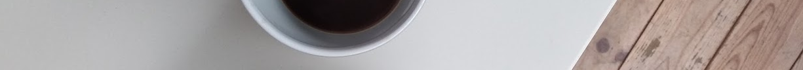
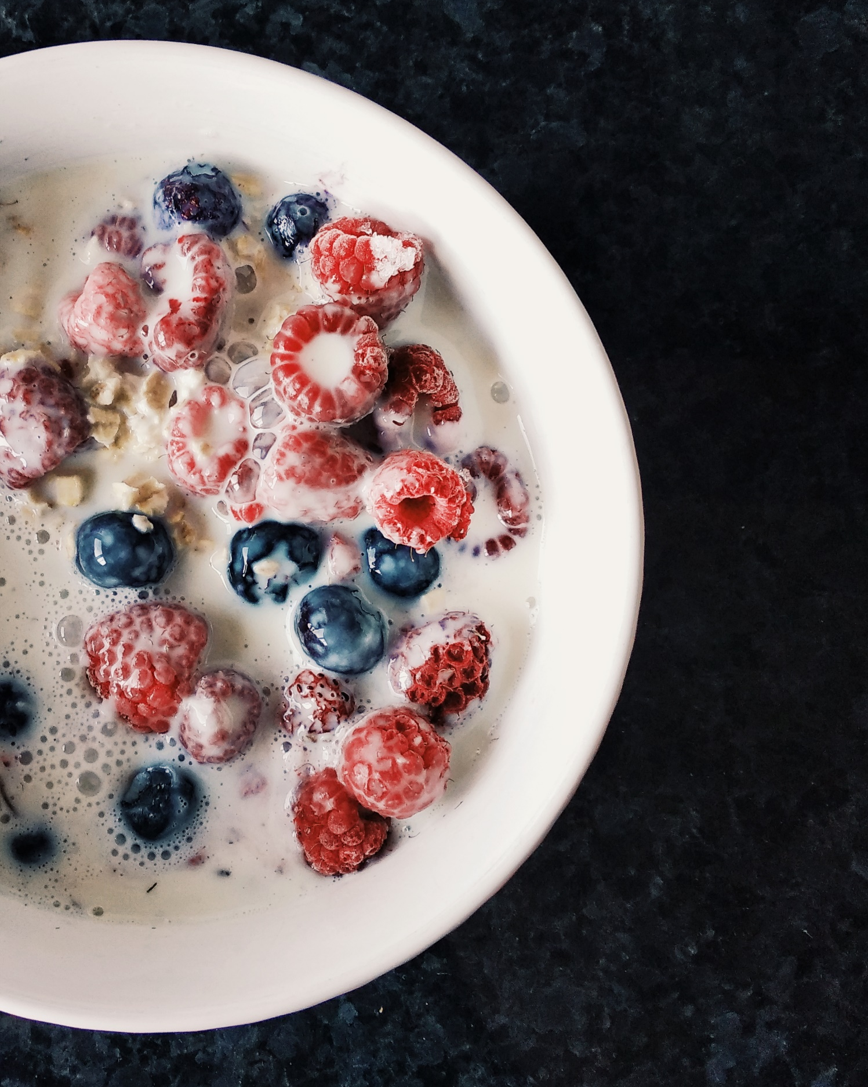
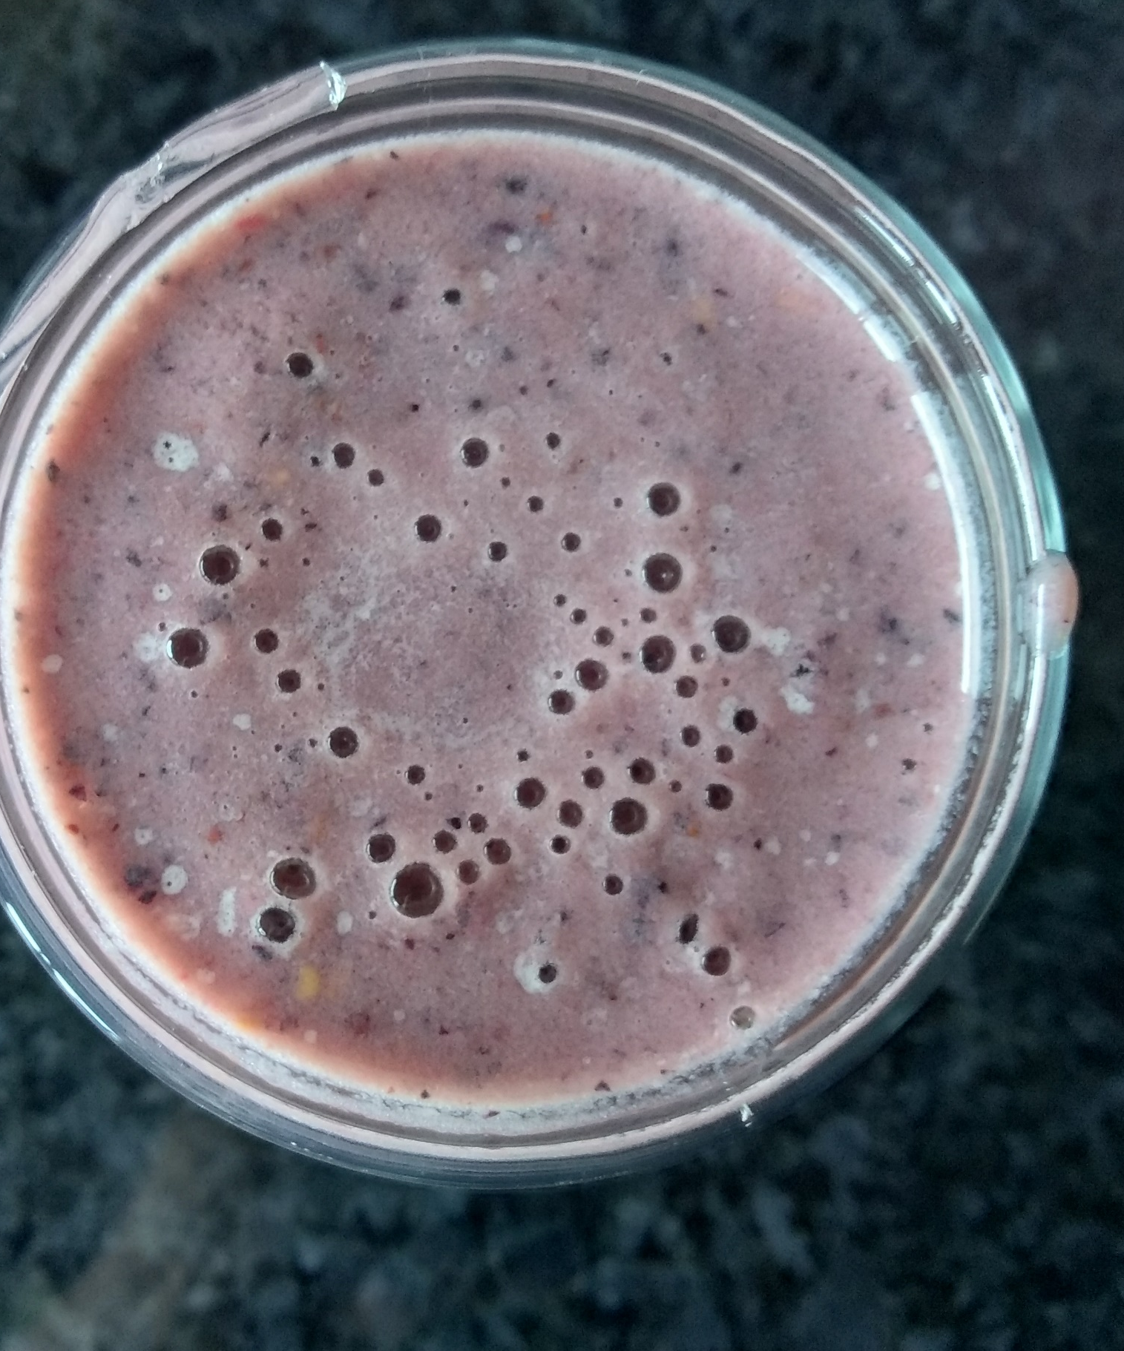
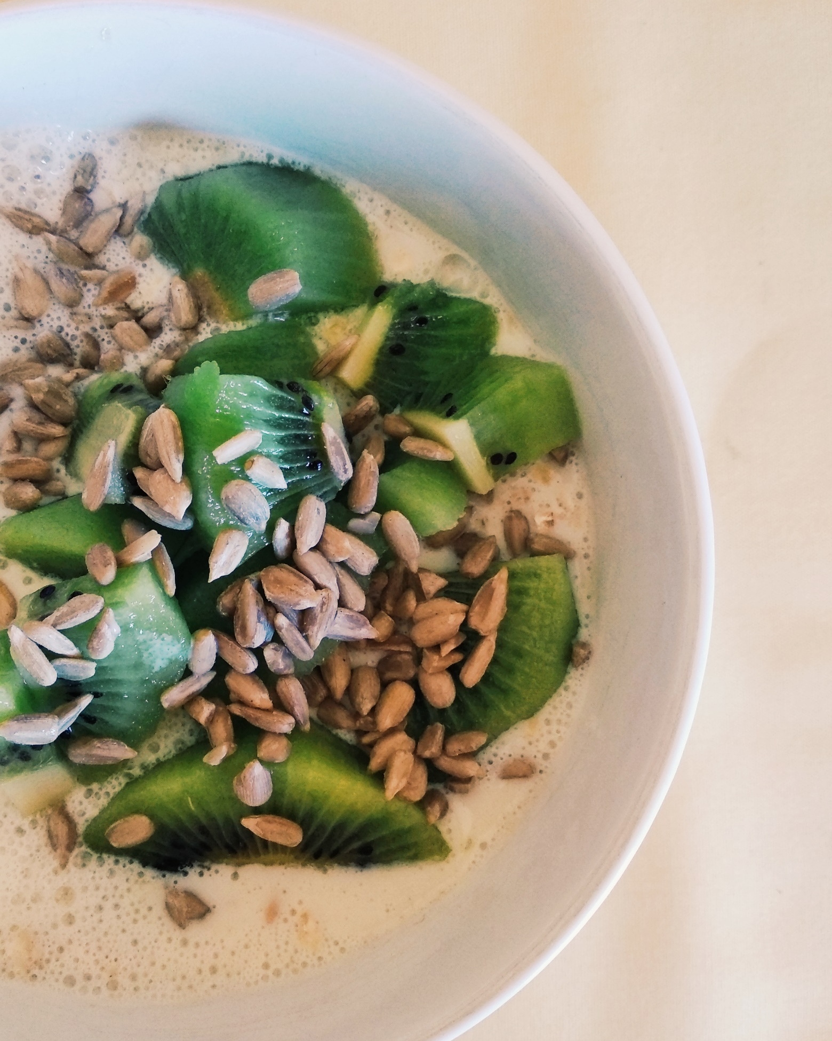
Recipes | Tips | About Me | Downloads
Dark Mode
Breakfast
Oatmeal with
Blueberries and raspberries
Red Fruits Smoothie
Oatmeal with
Kiwi and sesame seeds

Slide 22
Recipes | Tips | About Me | Downloads
Active: strong
Dark Mode
2,3 px
Breakfast
centered
Clickable
1,5px Margin
7,5 px
10px
Equal margins between images
All images same dimensions, rectangular
10px
Family-font: Bellota
Color: #865336
Text-align: left
Padding: 20px
Bckground-color: #FFE8D6
Transparency:25%
Oatmeal with
Blueberries and raspberries
Red Fruits Smoothie
Oatmeal with
Kiwi and sesame seeds
2,3 px

Slide 23



Recipes | Tips | About Me | Downloads
Dark Mode
Breakfast
Oatmeal with Blueberries and raspberries 5mins
Ingredients
200ml Vegetal milk
½ cup Frozen blueberries and raspberries
2 cups oatmeal
Preparation
Warm the milk
Let berries defrost
Add the oatmeal
Let it soften
Add berries

Slide 24
Recipes | Tips | About Me | Downloads
Dark Mode
Breakfast
Align left
¼ width
Proportional height
Oatmeal with Blueberries and raspberries 5mins
Ingredients
200ml Vegetal milk
½ cup Frozen blueberries and raspberries
2 cups oatmeal
Preparation
Warm the milk
Let berries defrost
Add the oatmeal
Let it soften
Add berries
Family-font: Bellota
Color: #865336
Text-align: left and right
Padding: 5px
Bckground-color: #FFE8D6
Transparency:25%
Family-font: Darker GrotesqueColor: #865336
Text-align: leftBckground-color: #FFE8D6
Transparency:25%
Unordered List
icons: graduation caps and salt&pepper

Slide 25
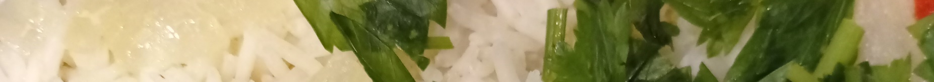
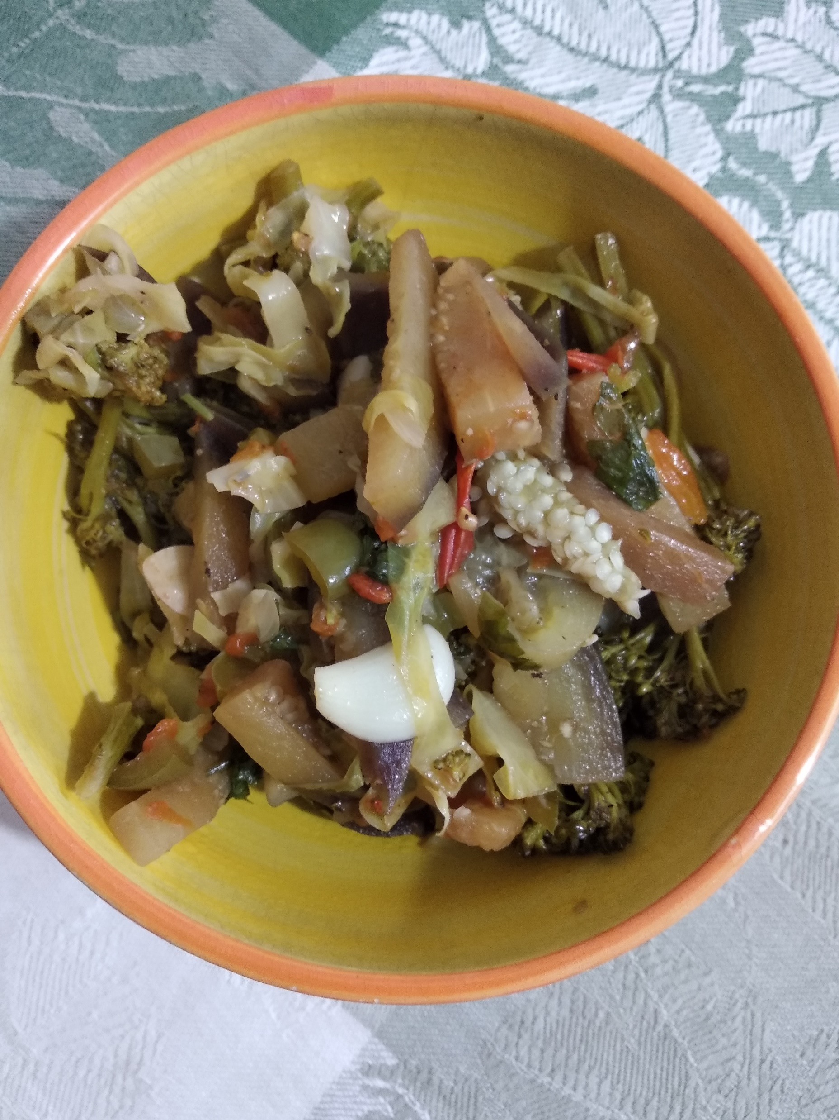
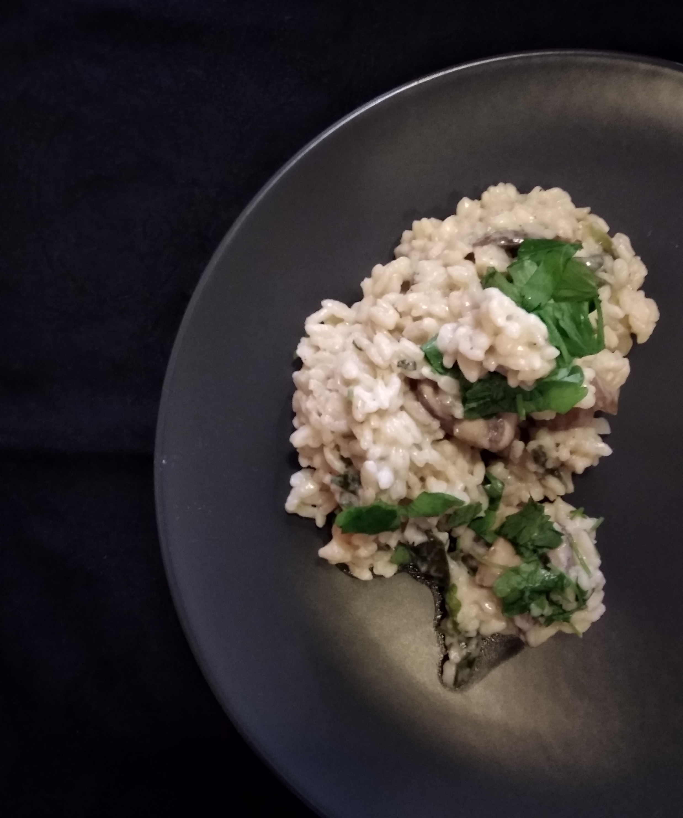
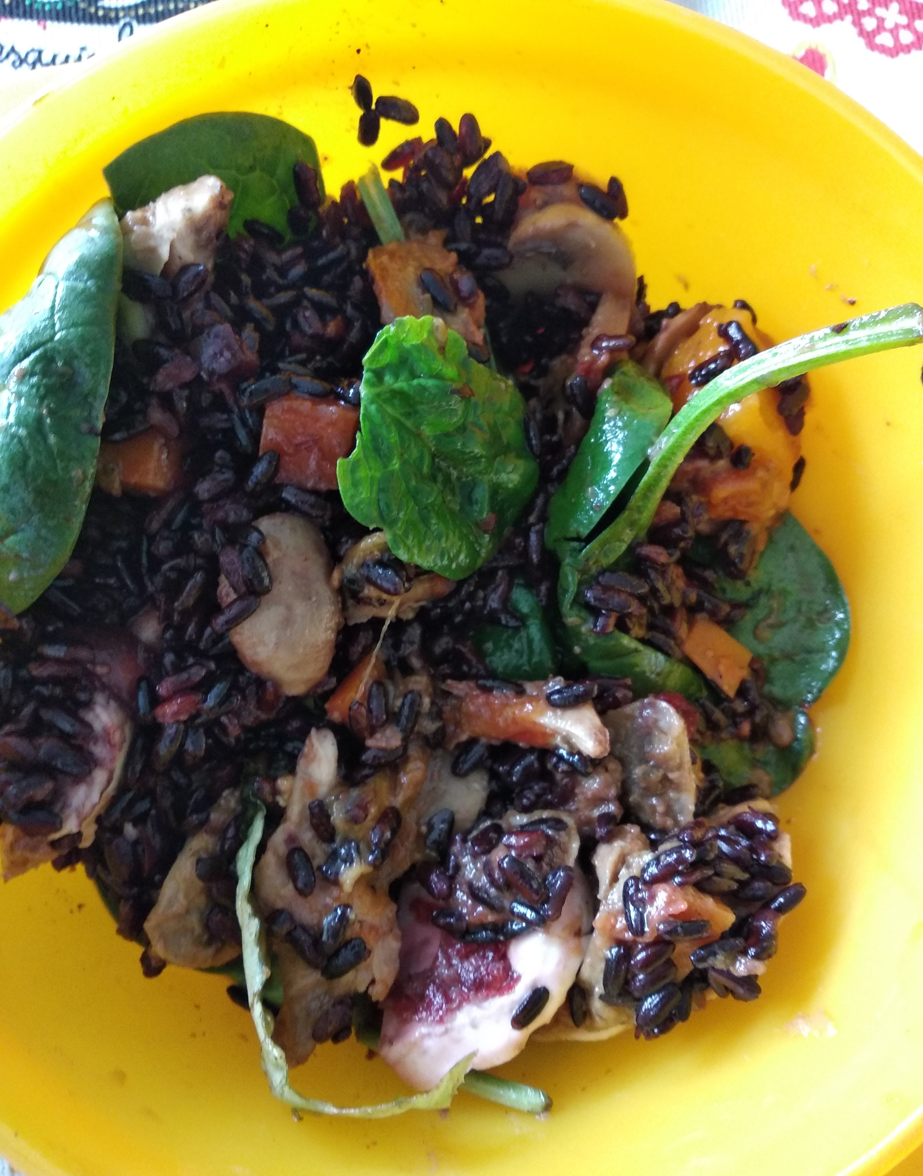
Recipes | Tips | About Me | Downloads
Dark Mode
Lunch and Dinner
Braised veggies
Mushrooms’ risotto
Summer Salad

Slide 26

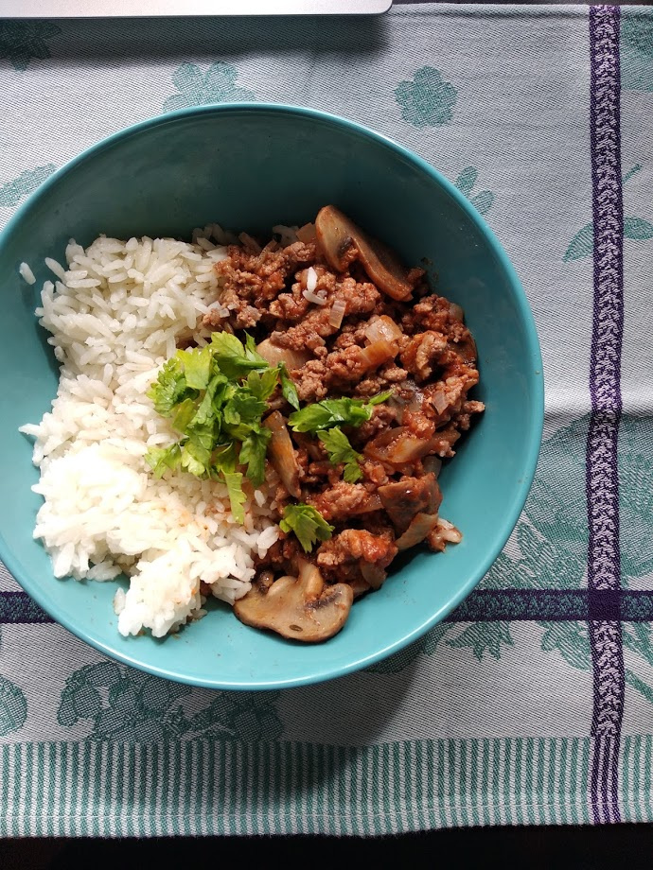
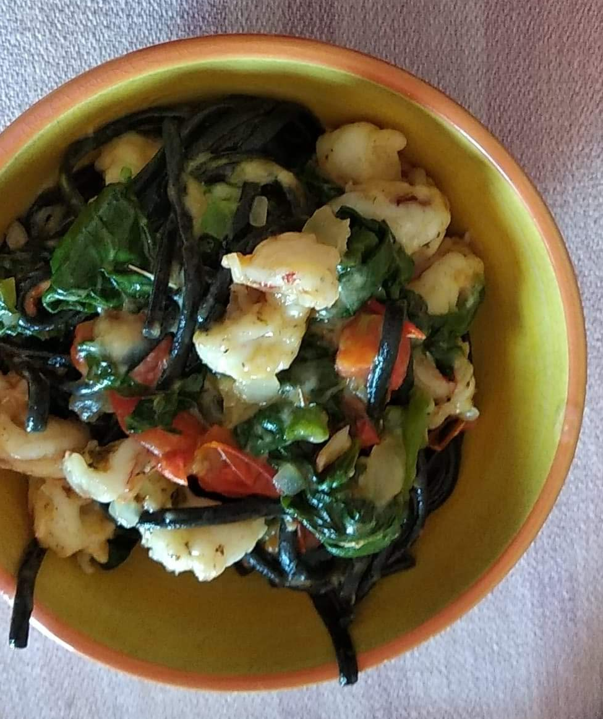
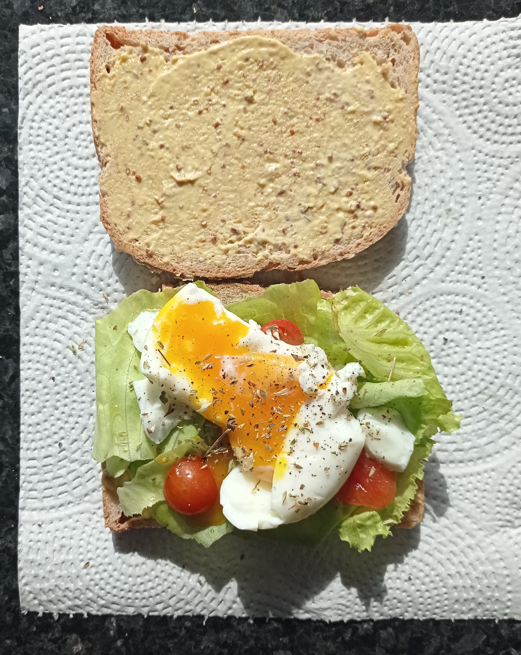
Summer Salad
Braised veggies
Mushrooms’ risotto
Summer Salad
Egg and humus sandwich
Shrimp and spinach pasta
“Bolognese” beef and mushrooms

Slide 27
Tips Page

Slide 28
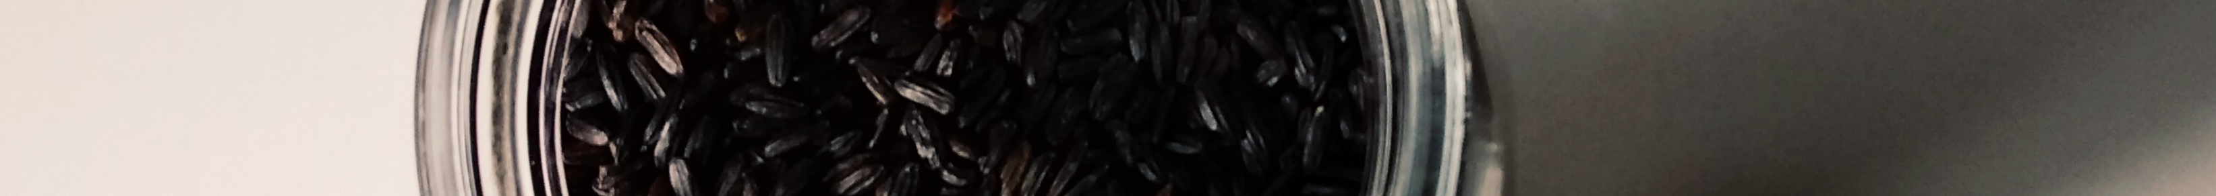
Recipes | Tips | About Me | Downloads
Dark Mode
Tips
Planning and organization
Create a meal plan for the week (example)
Buy groceries needed in advance
Sustainability
Try to buy local food
Add not so fresh groceries to the soup, you’ve forgotten in the fridge
Avoid plastic, you have more control on the aliments and help environment
Cooking tips
Use lemon slices when grilling fish: it’s tastier and saves time when cleaning
Always have soup at the refrigerator: it’s always a ready-to-eat meal

Slide 29
Recipes | Tips | About Me | Downloads
Dark Mode
Active: emphasized
Tips
1,5px margin
Margin 1/8
Planning and organization
Create a meal plan for the week (example)
Buy groceries needed in advance
Sustainability
Try to buy local food
Add not so fresh groceries to the soup, you’ve forgotten in the fridge
Avoid plastic, you have more control on the aliments and help environment
Cooking tips
Use lemon slices when grilling fish: it’s tastier and saves time when cleaning
Always have soup at the refrigerator: it’s always a ready-to-eat meal
Margin 1/8
External link
Text align left
2/4 width

Slide 30
About Me Page

Slide 31
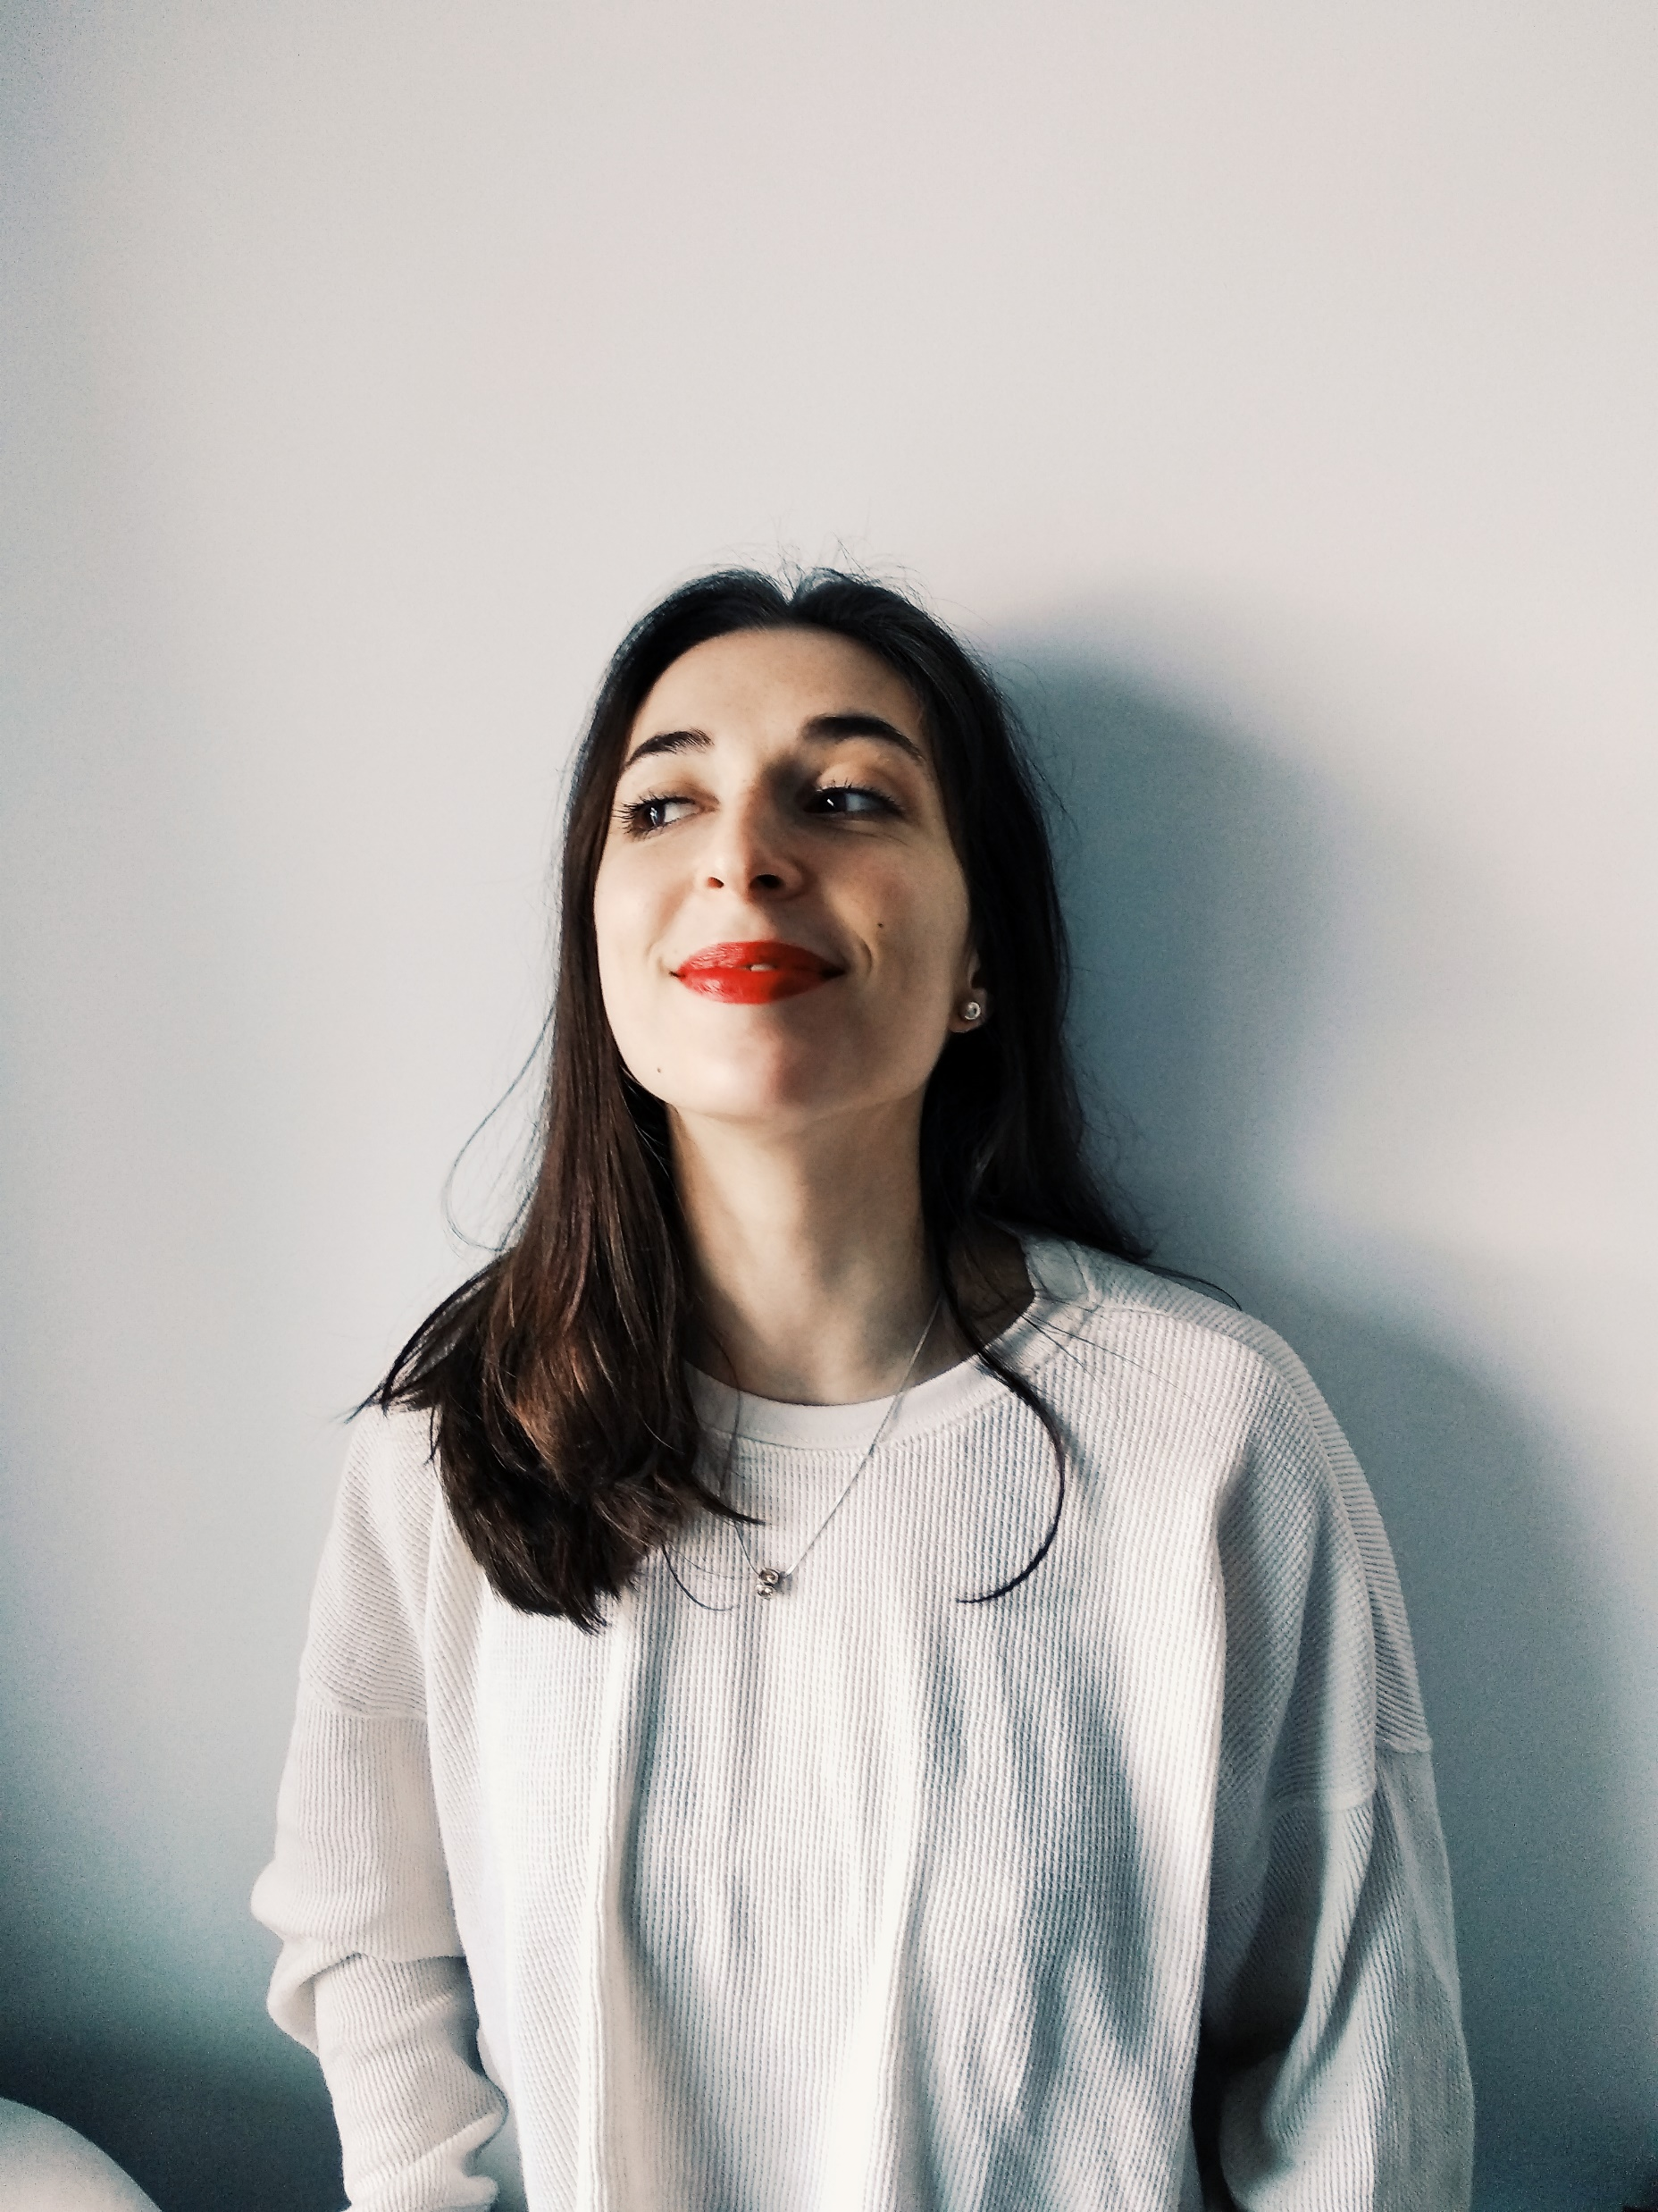
Recipes | Tips | About Me | Downloads
Dark Mode
About Me
Education
Some info
Some info
Some Info
Interests
Some interest
Some interest
Some interest

Slide 32
Recipes | Tips | About Me | Downloads
Dark Mode
Active: emphasized
About Me
1,5px margin
1,5px margin
Education
Some info
Some info
Some Info
Interests
Some interest
Some interest
Some interest
3px margin
Text align left
3/4 width (including margin)
Align left
¼ width
Proportional height

